Slide 1
Ex.Lec.3 Extraction of Aluminum from ore oxide
Dr. Ahmed Ameed
Introduction
Aluminum has many useful properties. It is the commonest metal in the rocks of
the Earth's crust. About 8% of the crust is aluminium, not the metal itself
combined with other elements as natural minerals, such as bauxite.
but
MAIN PROPERTIES OF ALUMINIUM
1. An excellent conductor of heat and electricity.
2. Aluminium does not rust, it resists corrosion.
4. Low density compared with other common metals.
5. Good reflector of heat and light, it has a good metallic lustre (surface shine).
6. Nonmagnetic.
7. Can be alloyed to form stronger or harder alloys than pure aluminium.
8. Easily workable. It can be rolled into sheets, foil, and wire; cast or forged into useful shapes.
• Aluminium ores are
Bauxite
Al2O3.nH2O (Main)
Gibbisite Al2O3.3H3O
Diaspore
Al2O3.H2O.
It contains impurities as well as aluminium oxide. The bauxite must be
purified to give alumina (Al2O3).
• Aluminium is a very reactive metal, much more reactive than copper, iron or
lead. Other metals have been extracted for thousands of years by heating
them with carbon (smelting). Carbon is also needed to extract aluminium,
but in a completely different way.
• Ore dressing– cleaning ore by means of separation of the metal containing
mineral from the waste (gangue).
1

Slide 2
Ex.Lec.3 Extraction of Aluminum from ore oxide
Dr. Ahmed Ameed
Bayer Process
•
The bauxite ore is crushed and ground to produce slurry of coarse powder
particles suspended in water.
Sodium hydroxide (caustic soda) NaOH is added, and the slurry is heated with
process steam to 160-180ºC in a steel reactor or autoclave with pressure. The
aluminum-containing hydroxides are dissolved during this digestion process, but
other constituents of the bauxite remain solid.
The digested bauxite suspension, which contains solids plus dissolved Al
compounds, is referred to as pregnant liquor. It leaves the digester at about
boiling temperature and passes through several stages of filtration referred to as
clarification.
Precipitation is conducted in large flat-bottomed tanks about 30 m high and 10-
12 m in diameter with typically 10 to 14 in a series. Cooled supersaturated liquor
enters the first tank, and particles of aluminum hydroxide begin to precipitate.
Seeds (small particles of aluminum hydroxide) are added to accelerate
precipitation.
Classification in which the aluminum hydroxide particles are separated from the
liquor by a combination of cyclones and hydroclassifiers. The coarser particles
proceed to the calciner. The finer particles are recycled as seeds.
Calcination is the final step of the Bayer process. The particles are dried and
heated to 1100C in either a rotary kiln (a tubular-shaped furnace that rotates as
the powder passes through) or a fluidized bed (the kiln is stationary, but the
powder is mixed by air bubbled through the powder bed).
The aluminum hydroxide Al(OH)₃ (is decomposed to form aluminum oxide (Al₂O₃)
particles suitable for the Hall-Heroult electrolytic smelting process.
•
•
•
•
•
•
2

Slide 3
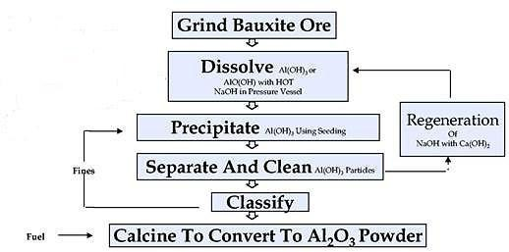
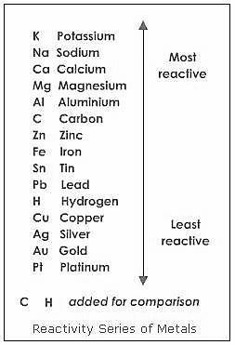
Ex.Lec.3 Extraction of Aluminum from ore oxide
Dr. Ahmed Ameed
Choosing the method to extract a metal from its ore.
•
Carbon can be used to extract metals lower in the series, ones which are less
reactive than carbon. For example, iron from iron oxide (haematite) or tin
from tin oxide (cassiterite).
Carbon is less reactive than aluminium. This is
why we need a different method, electrolysis,
to extract aluminium from its oxide (bauxite).
The rule is: Carbon can displace less reactive
metals from their ores.
The carbon forms the anode block and the
lining of the pot (the electrolytic cell), the
cathode. As electricity flows between them the
alumina splits into liquid aluminium metal
and oxygen gas.
•
•
Dissolved alumina --> aluminium metal + oxygen gas
The key to this method of extracting aluminium (Hall-Heroult process) was to find a
material which could dissolve the alumina. A natural ore called cryolite was used,
3

Slide 4
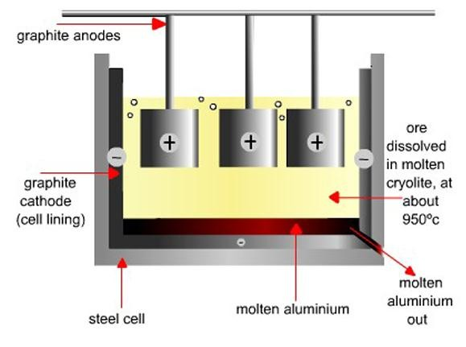
Ex.Lec.3 Extraction of Aluminum from ore oxide
Dr. Ahmed Ameed
although the cryolite is prepared artificially now. Each pot can produce about one
ton of aluminium each day. The hot liquid metal is removed regularly from the pot and cast into blocks or ingots.
In principle, aluminium could be produced by melting aluminium oxide (alumina)
and passing an electric current through it. Unfortunately the oxide is a refractory material with an exceptionally high melting point of about 2000ºC. Refractories are used to line furnaces.
The function of cryolite is to lower the melting point of aluminium oxide. By
dissolving the alumina in a second aluminium compound (cryolite,
Na3AlF6)
the
extraction process can operate at a more economical temperature of 950C.
There is very little alumina in the melt, about 5% alumina and 95% cryolite. Fresh alumina is added regularly as the electrolysis proceeds.
When electric current passes between the anodes and the cathode through the
cryolite, aluminum oxide decomposes to metallic aluminum deposited at the cathode and oxygen liberated at the anode.
4

Slide 5
Ex.Lec.3 Extraction of Aluminum from ore oxide
Dr. Ahmed Ameed
The molten aluminum is periodically tapped from the furnace into a crucible and
cast into ingots.
Electrode Reactions
The carbon cathode (negative electrode) is the lining of the pot.
Al³⁺ + 3 e-
Al metal
(Reduction)
The aluminium ions gain electrons from the cathode and become aluminium atoms.
The carbon anodes (positive electrodes) are made by baking a mixture of petroleum
coke and pitch (يطفنلا كوكلا محفوراقلا جيزم). Carbon (graphite) is the only non-metal that is a good conductor of electricity.
2O ⁻²
O2 + 4 e-
(Oxidation)
The oxide ions lose electrons to the anode and become oxygen gas. There is a
problem when hot carbon (the anode) comes into contact with oxygen. The anode burns away to form carbon monoxide and carbon dioxide gases. The anode is slowly lowered into the melt as the surface burns away.
2C + O2
2CO
C + O2
CO2
5

